Slide 1
Redefining Language, Identity, and Heritage through a more-than-human lens
Jessica Hampton (PhD) & Denéa S. Buckingham (MPhil)
Notes:
JH

Slide 2
01
02
03
04
05
06
Introduction
Theoretical Frame
Examples
Language-as-Heritage and Unbordering Dichotomies
Implications
Conclusion
Notes:
JH

Slide 3
01
Introduction(s)

Slide 4
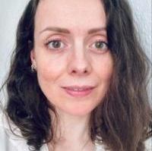
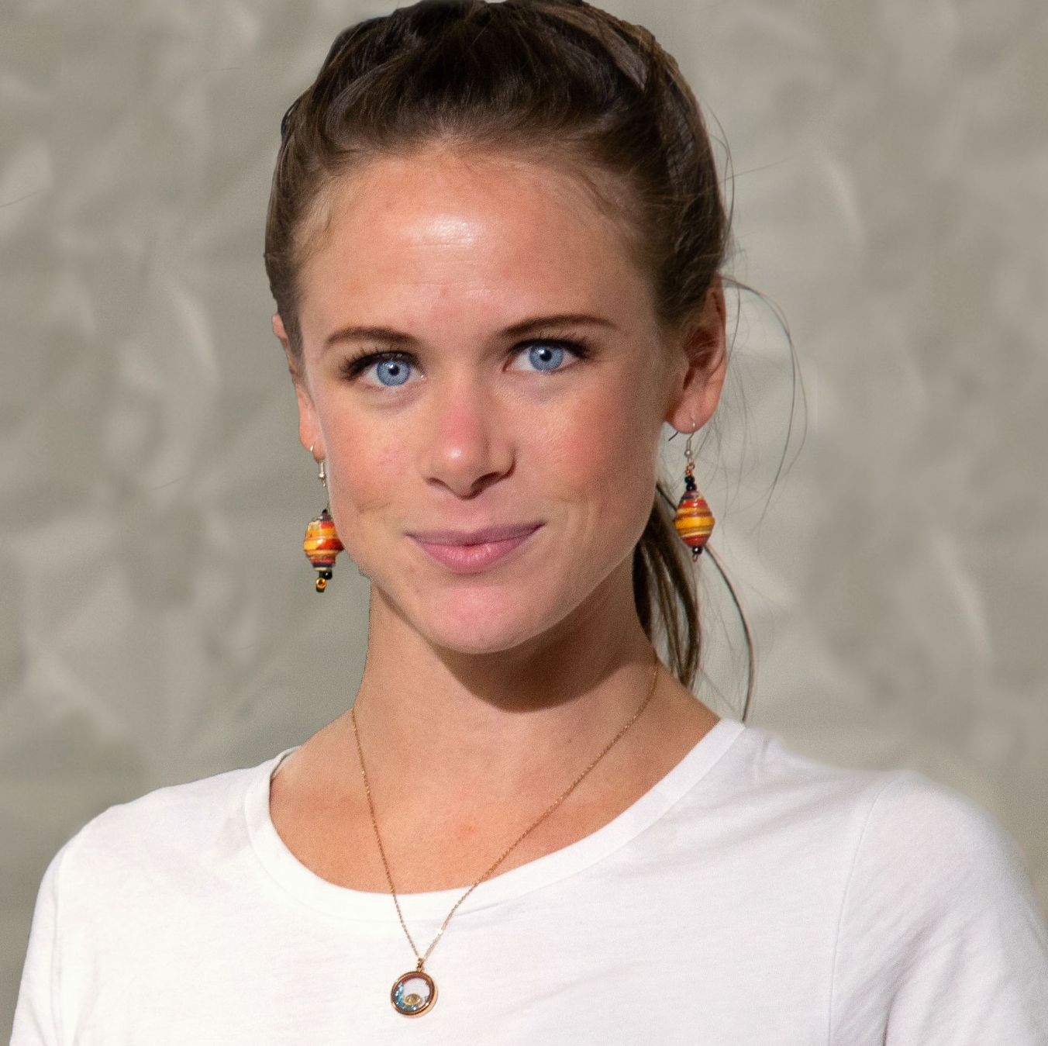
Jessica Hampton
Denéa S. Buckingham
Researcher/Lecturer (University of Liverpool)
PDRA - ARRC (University of Cambridge)
PhD, Eco/Sociolinguistics (University of Liverpool)
Co-convenor, International Ecolinguistics Association
MPhil, Heritage Studies (University of Cambridge)
Co-convener, Water and Heritage Working Group (Australia), ICOMOS
Fellow, Royal Geographical Society
Senior Heritage Advisor, Western Australia
Notes:
JH

Slide 5
Jessica Hampton
Denéa S. Buckingham
Researcher/Lecturer (University of Liverpool)
PDRA - ARRC (University of Cambridge)
PhD, Eco/Sociolinguistics (University of Liverpool)
Co-convenor, International Ecolinguistics Association
MPhil, Heritage Studies (University of Cambridge)
Co-convener, Water and Heritage Working Group (Australia), ICOMOS
Fellow, Royal Geographical Society
Senior Heritage Advisor, Western Australia
With many thanks to Arran Stibbe
Notes:
DB

Slide 6
02
Theoretical Frame

Slide 7
Language, identity, and heritage shape how we narrate our place in the world (Hampton & Buckingham 2026)
Identity
How are we re-negotiating our formations of self amidst unprecedented social and environmental upheaval?
Ecolinguistics
Heritage Studies
Investigating ‘the role of language in the life-sustaining interactions of humans with other species and the physical environment’ (Stibbe 2021: 203)
Theoretical shift of ‘attention onto performativity as a description of the emerging dynamics of subjective engagement with things, space and time’ (Waterton and Watson 2013: 551)
Notes:
JH-> eco
DB-> Identity and HS
We draw from ecocutural identity, foundational econarratives, environmental psychology and Tim Ingold’s concepts of enmeshment and movement
Recognizing language, identity, and environment as inextricably linked, the erosion of one destabilizes the others. The way language embeds individuals and communities within the living world reinforces a sense of belonging and continuity. Language does not merely describe reality, it actively constructs it (Halliday [1990] 1992), shaping relationships with both human and more-than-human environments.

Slide 8
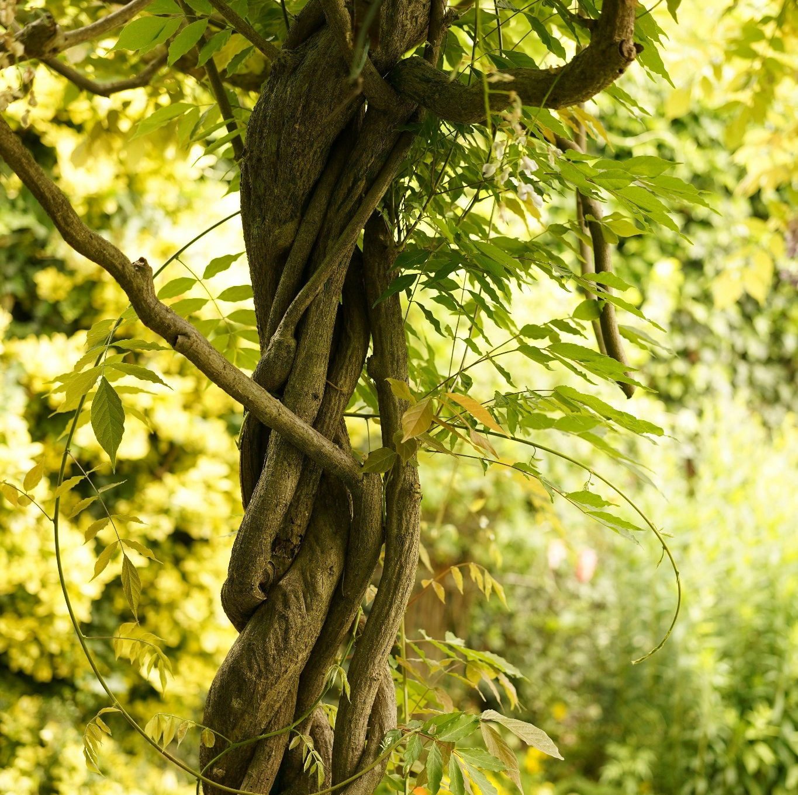
Language sustains relation
Language as ecological memory (Hampton 2022)
Identity embedded in place (e.g., Clayton 2021; Milstein and Castro-Sotomayor 2020)
Discourses embody care, value, attention, labour (e.g., Halliday 1999; Steffensen 2015)
More-than-humanist critique of anthropocentric hierarchies (e.g., Steele et al. 2019; Brierley 2019)
Ecologies enmesh linguistic systems into living well in a place.
Notes:
JH-> This is why - what we’re trying to address of how language sustains relations
Intentionality, reciprocity and distributed language
Also in line with “More-than-human theory not only critiques anthropocentric hierarchies but also advances new ontologies that recognize the agency, relationality, and intrinsic worth of more-than-human kin”

Slide 9
03
Examples
Notes:
DB - now that we have ….

Slide 10

…language serves as both a repository for ecological knowledge and a tool for fostering intergenerational connections with the more-than-human world.
(Hampton & Buckingham 2026)
“Bahara” (v.) to appear under water (O’Dell 2024)
—Kumzari ( کمزاری )

Slide 11
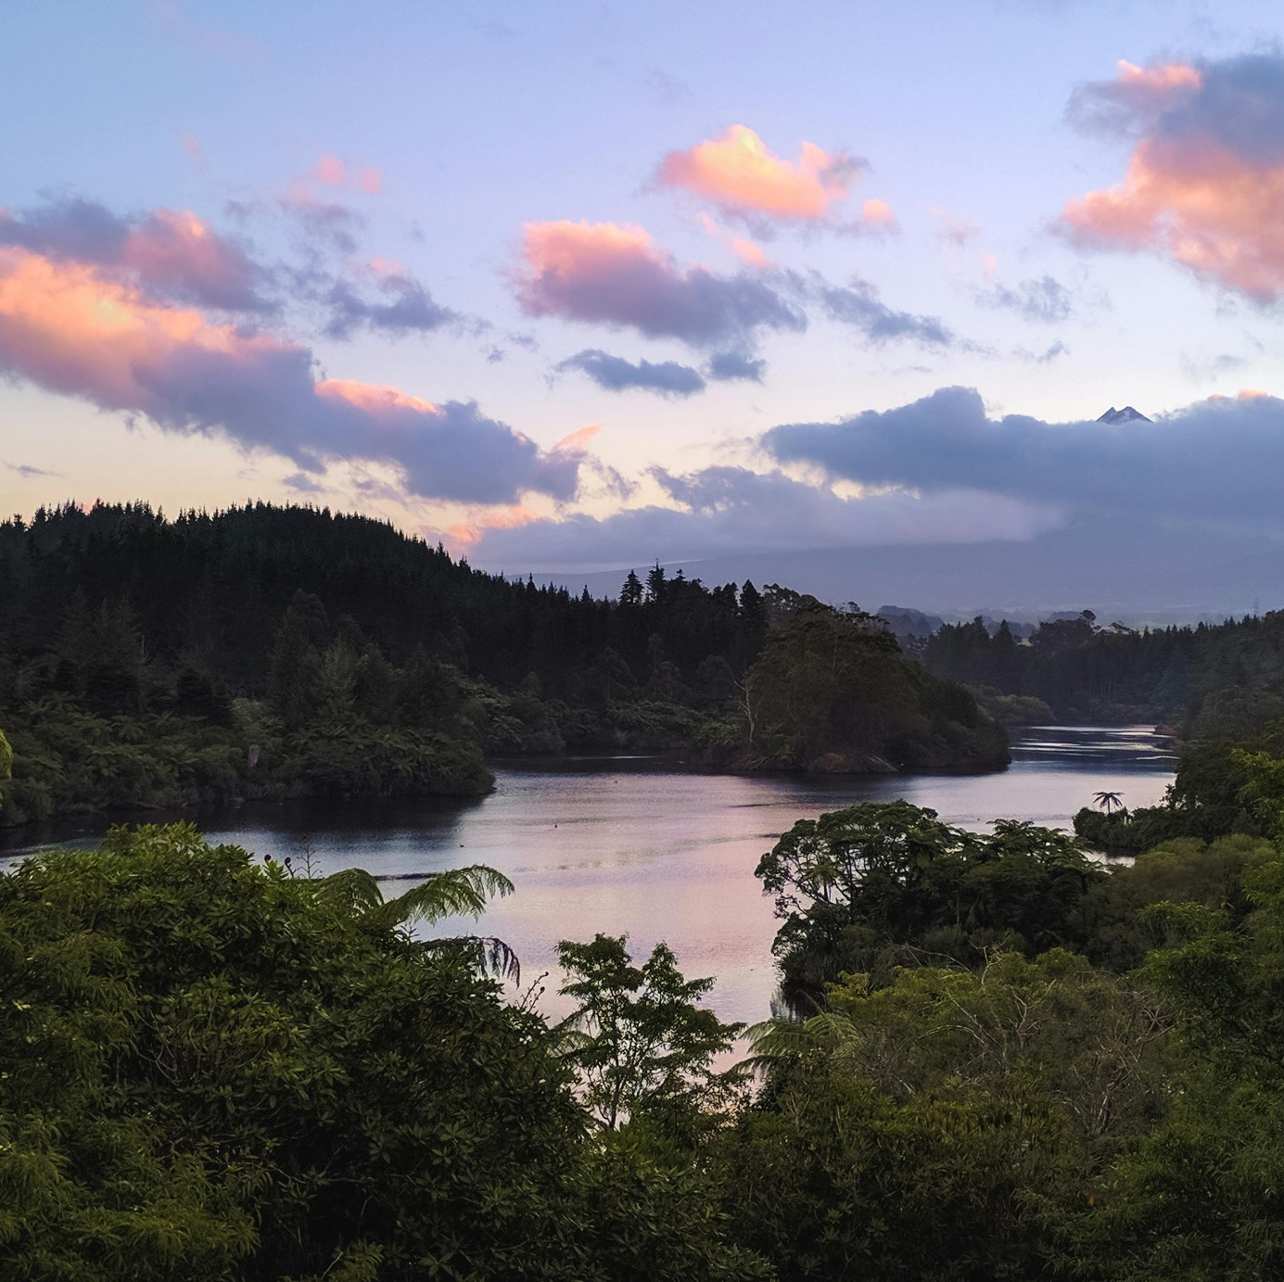
…language serves as both a repository for ecological knowledge and a tool for fostering intergenerational connections with the more-than-human world.
(Hampton & Buckingham 2026)
“Bahara” (v.) to appear under water (O’Dell 2024)
—Kumzari ( کمزاری )
“Ko te awa ko au, ko au ko te awa” (phrase) I am the river, and the river is me
—Te Reo Māori
Notes:
Symbiotic and inextricable integration of identities between people and more-than-human beings
A now iconic phrase that echoed throughout the world upon the first river being acknowledged as a legal person and to this day embodies the cosmological foundations of the Rights of Nature movement from the mountains of New Zealand to the streets of New York City.

Slide 12
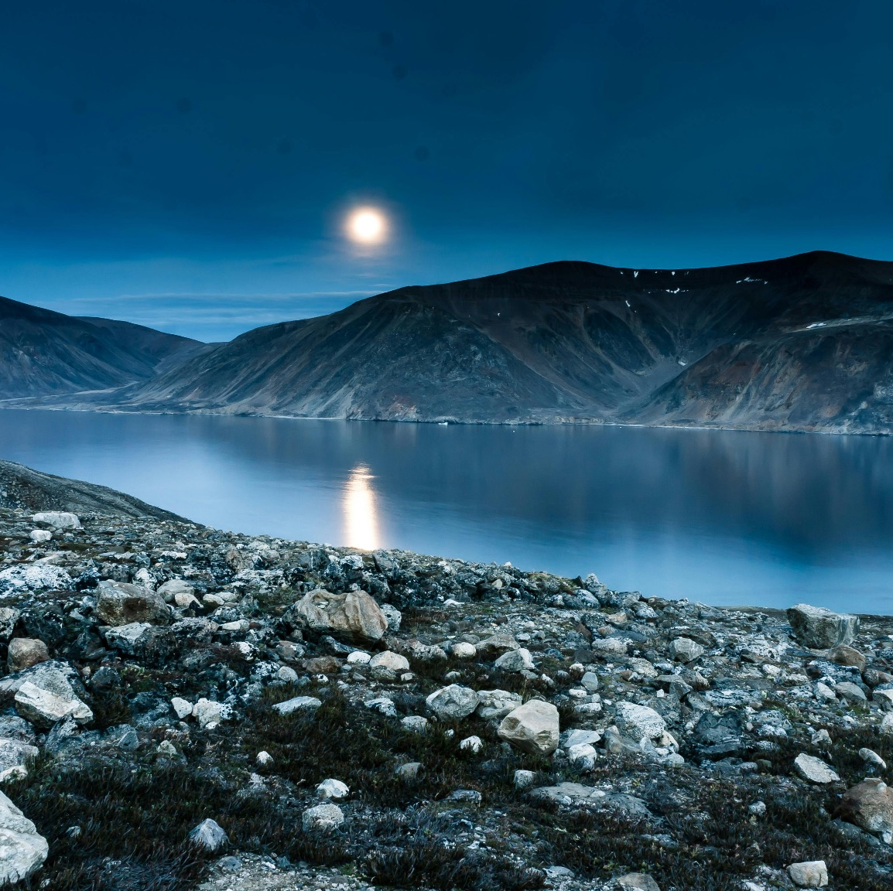
…language serves as both a repository for ecological knowledge and a tool for fostering intergenerational connections with the more-than-human world.
(Hampton & Buckingham 2026)
“Bahara” (v.) to appear under water (O’Dell 2024)
—Kumzari ( کمزاری )
“Ko te awa ko au, ko au ko te awa” (phrase) I am the river, and the river is me
—Te Reo Māori
“Anirniq” ( ᐊᓂᕐᓂᖅ ) (n.) the spirit in all things, foundational to the idea of ‘treat everything as if alive’ (Kalluk 2017, referenced in Sheremata 2018: 77)
—Inuktitut ( ᐃᓄᒃᑎᑐᑦ )
Notes:
Similarly, the noun “aniriq” - and please correct me if there any Nunnavut Inuktitut speakers or scholars in the room - encapsulates a cosmology in a noun. A worldview in a word. Living with the land, walking carefully across sentient rocks, and respecting the diverse communities who make up our more-than-human world.

Slide 13
…knowing is not a detached cognitive process but a deeply embodied and
ecological act—an ongoing negotiation between beings and their environments
(Hampton & Buckingham 2026).
Notes:
DB: all of the previous elements of speech point to this. We are not other, we are *one* another.

Slide 14
Insights from Heritage Studies
Process over product
“Exfoliating binaries”
From “things” to how we navigate the world with things, and why we create the world around us as we do (Sørensen & Carman 2009; Smith 2006)
Blurring the lines between “us” and “them”; dismantling the nature vs culture divide (Bangstad & Pétursdóttir 2021)
Unconscious curation
Transcending Humanism
Exploring the processes through which we constantly (re)create our cultures, both the tangible and the intangible “stories we live by” (Stibbe 2015; 2021)
Acknowledging our academic ancestry, whilst also continuing to scrutinise the future/s it leads towards (Waterton & Watson 2015)
However, heritage studies remains predominantly focused on human culture.
Notes:
DB: Heritage studies, at its core, asks - if anthropology is who we are, and archaeology is what we make, then heritage asks how and why we do so.
But the heritage studies of today is considerably far from its material culture-focused predecessors. Moving from a preservationist preoccupation following the global decismation of two world wars (not to mention the colonial atrocities that preceded them), contemporary heritage studies explores who we are by looking at how we portray ourselves in the world.
From the 1980s, but gaining momentum in the 2000s, heritage scholars began thinking less of heritage as a noun and more of heritage as a *verb*. It hurts the brain a little though, doesn’t it - how do we _heritage_? What that means, according to Laurajane Smith, ## Sorensen, and John Carman, is that we must shift focus to the processes through which we create, and engage with heritage. Heritage is a process.
This processual turn, in turn, offered an adept tool for “exfoliating” (to borrow a perfect verb from Torgir Rinke Bangstad and Dora Pettursdottir) long-held and siloed binaries. We are not “nature” or “culture” if we are constantly creating and recreating both through the psychological, emotional, and sociological actions that allow us to draw the lines in the sand in the first place.
Importantly, contemporary Heritage Studies - although a great deal of it continues to address human concerns - now widely rejects the static and staid values that arose from the Renaissance in conjunction with an ideal of cultural heritage as the immovable, pristine, and irreplaceable statues of pre-world war Europe. As ## daringly continues to argue - there is always more archaeology to find.
Finally, heritage is constantly, unconsciously curated by every member of a culture, every day, because they are adapting to the inevitable changes in their surroundings, time periods, and both internal and external influences.
Sound familiar?
To me, when I started learning about ecolinguistics, these foundational tenets of Heritage Studies sounded a lot to me like language. And the way we use language to not only navigate but negotiate, notice, and innovate (???? - OTHER VERB??) the world around us.
Moreover, heritage is underpinned by culturally relative worldviews, and by exploring the ways in which different beings communicate their lived experiences in the world around them as elements of cultural heritage, we can better understand our perceptions of self _AS_ the world around us. In turn, Olga Bialostocka’s 2017 argument that language IS heritage becomes crucial to our cultural, linguistic, and ecological identity.

Slide 15
A more-than-human perspective reveals both language and heritage as relational and dynamic rather than static and extractivist.
(Hampton & Buckingham 2026; building on “more-than-human heritage” in Buckingham 2024)
Notes:
DB: For my Masters thesis, I sized up the ideological, linguistic, and cosmological identities of UNESCO’s Natural Heritage and the - at that time - emergent Rights of Nature eco-social movement. I asked whether, given their shared goal of protecting nature, whether these two extremely different entities had any intersections, or, potentially, mutually beneficial overlaps in which they might strengthen their individual causes together.
A key difference, I found, was the foundational “stories” upon which each is built. One takes a predominantly human OR natural perspective that particular aspects of nature warrant protections because they are _particularly_ special, either for natural or human reasons. The other argues that we are all part of a wider and far more elegantly - and eloquently - entangled more-than-human whole in which all parts are essential.
This more-than-human epistemology, as coined by David Abrams (####), I found, again liquefies the borders of how we perceive heritage -- we are constant co-creators of more-than-human heritage: “ QUOTE MY DEFINITION FROM MY THESIS HERE”
My concept of a more-than-human heritage speaks (puns always intended) directly to ecolinguistics - as we inevitably co-create our processes through which we engage in (and with) the more-than-human world around us, so too are our languages inextricably intertwined with the ecologies in which they evolve.
Ecolinguistics is a form of more-than-human heritage.

Slide 16
04
Language-as-Heritage and Unbordering

Slide 17
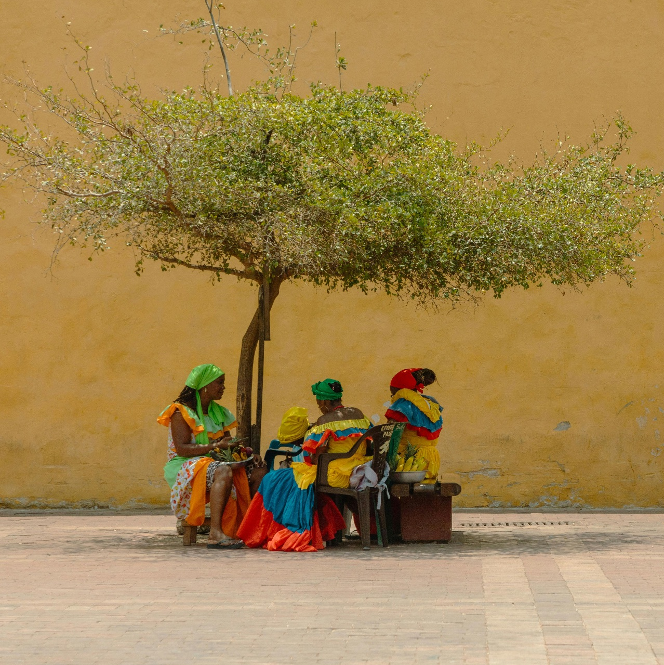
Language-as-heritage
Colonisation / Capitalism parallels (Monbiot and Hutchinson 2024; Ó Ceallaigh 2022)
Language as living (and ever-evolving) heritage (Bialostocka 2017)
Social unrest and environmental degradation (re)shapes language - what kind of thing is being lost or sustained? And why?
Theories of continuity that underpin heritage studies call into question not only language use but cultural transmission, responsibility, and curation as well.
Notes:
JH

Slide 18

Bordering and Unbordering
Nature out there/culture here (Abram et al. 2020)
Dichotomies as a bordering practice: everyday actions of “doing and undoing boundaries between the Self and the Other” (Tufi 2024: 137)
Dichomoties as bordering narratives: constructed and negotiated through discourse
An ontology of relationality and interconnectedness centred on movement (Ingold 2018) as an unbordering practice/narrative
Notes:
JH

Slide 19
language emerges not only as a mediator of relationships but as a form of heritage-a repository of narratives, practices, and ways of being that are inseparable from the landscapes and ecosystems they inhabit.
(Hampton & Buckingham 2026)
Notes:
JH

Slide 20
05
Implications

Slide 21
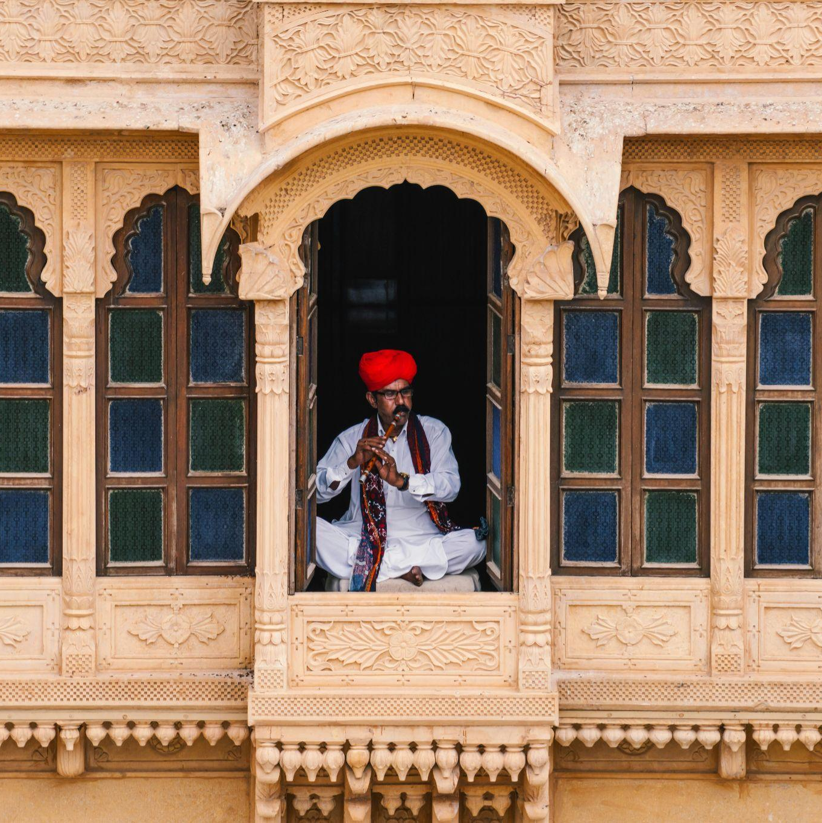
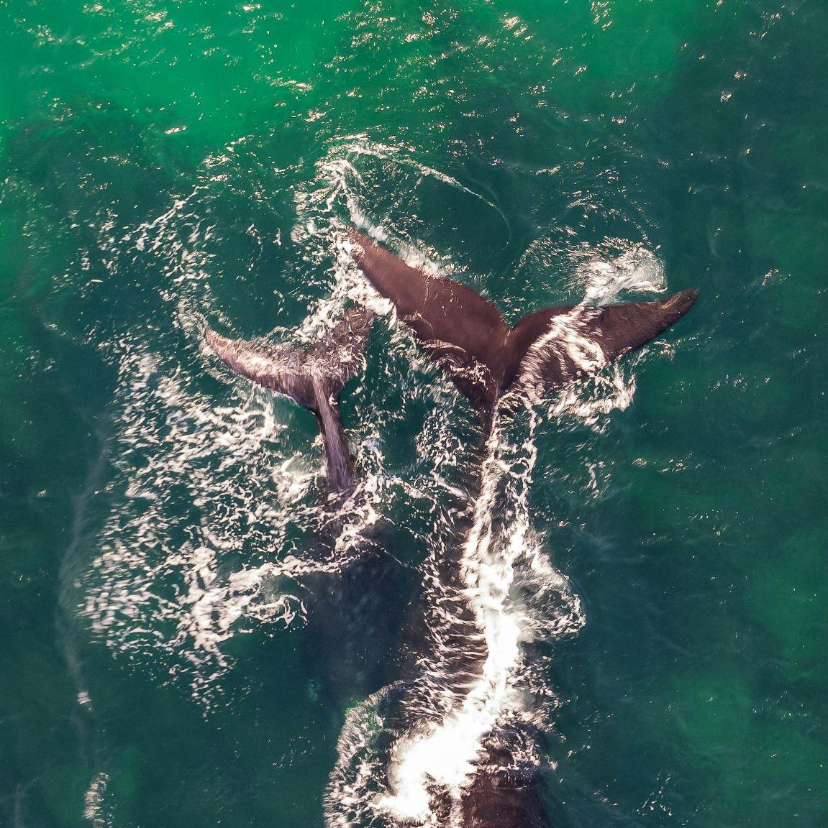
Implications for Heritage Studies
Embrace and explore language-as-heritage
Move beyond “is language heritage?” to explore their relationship
Revisit the insights of language in relation to heritage questions
Consider the implications of heritage theory and praxis in conjunction with advances in ecolinguistics
Ask more-than-human questions…and listen for the answers
Scrutinise static assumptions of language, linguistic revitalisation/conservation, and language change
Expand considerations of how more-than-human beings, too, create heritage (and their own heritage)
Ask how we can learn to ask - in more-than-human languages

Slide 22

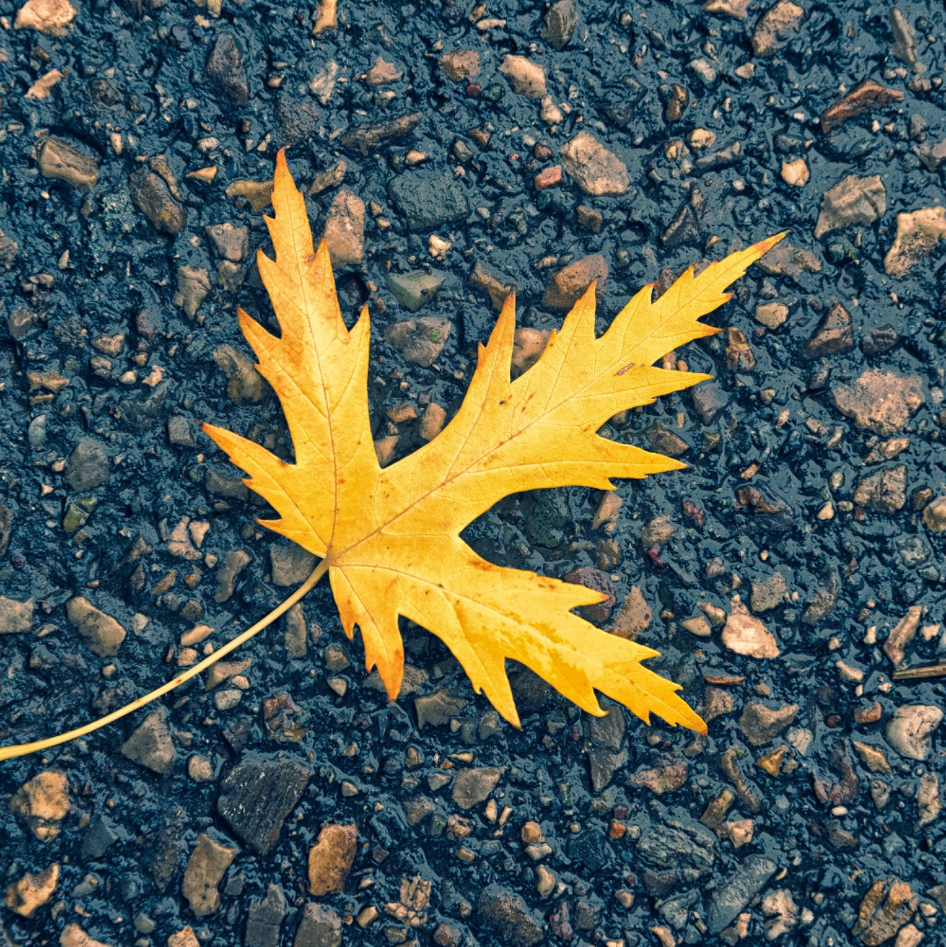
Implications for Ecolinguistics
From preservation to cultivation
…engaging with a processual perspective from heritage studies
language as a living practice shaped by interactions with place, history, and identity.
language as integral to ecocultural identity, deeply connected to landscapes, traditions, and ways of knowing (revitalisation)
deconstruction of borders (language/dialect)
Redefining language
Language(s) not static object(s) to preserve
ecological wisdom in historically marginalised communities
Focus on the mundane
Notes:
By integrating heritage studies, ecolinguistics can expand its scope to better address the cultural, material, and historical dimensions of language
By drawing on the processual perspective of heritage studies, linguistic research would be underpinned by an understanding of language as a living practice shaped by interactions with place, history, and identity. This shift is particularly relevant for minoritized language communities facing both linguistic and environmental pressures. A heritage-informed eco/linguistics recognizes language as integral to ecocultural identity, deeply connected to landscapes, traditions, and ways of knowing.
the deconstruction of borders, informed by heritage studies, challenges hierarchical structures in linguistics that prioritize languages over dialects. A focus on the mundane promotes a much needed decolonial approach to knowledge production, and ecolinguists can apply this by seeking ecological wisdom in marginalized communities, such as Roma people, miners, and speakers of Liverpool English
Languages are not static objects to preserve, but dynamic ways of knowing to cultivate-offering a transformative vision for both disciplines, grounded in the past yet aimed at informing a better future in alignment with the more-than-human world.

Slide 23
06
Conclusion

Slide 24
Language(s) as dynamic ways of knowing to cultivate-offering a transformative vision for both disciplines, grounded in the past yet aimed at informing a better future in alignment with the more-than-human world.
(Hampton & Buckingham 2026)
Notes:
JH: We thus redefine language, and languages, as dynamic ways of knowing…
DB: If language is heritage, then we as linguists are also responsible for the ethical continuation of a profound form of heritage. We must also ask the question of how we attune ourselves, and our discipline, to better hear the calls of more-than-human voices.

Slide 25
Abram, D., Milstein, T. and Castro-Sotomayor, J. 2020. “Interbreathing Ecocultural Identity in the Humilocene”, in Tema Milstein and Jóse Castro-Sotomayor (eds.) Routledge Handbook of Ecocultural Identity. London: Routledge.
Bangstad, T. R., & Pétursdóttir, Þ. (Eds.). 2021. Heritage ecologies. Routledge, Taylor & Francis Group.
Bialostocka, O. 2017. “Inhabiting a Language: Linguistic Interactions as a Living Repository for Intangible Cultural Heritage.” International Journal of Intangible Heritage, 17:18–27.
Brierley, G. 2019. Finding the Voice of the River: Beyond Restoration and Management. Cham: Springer Nature.
Buckingham, D. 2024. Towards a More-than-human Heritage: Exploring the Intersection of Natural World Heritage and Rights of Nature, Past, Present, and Prospects. MPhil thesis. University of Cambridge.
Clayton, S. 2003. Environmental Identity: A Conceptual and an Operational Definition. Cambridge, MA: MIT Press.
Halliday, M.A.K. 1992. “New Ways of Analysing Meaning: A Challenge to Applied Linguistics.” In M. Pütz (ed.), Thirty Years of Linguistic Evolution. Amsterdam: John Benjamins, 59–96. [Originally published 1990.]
Hampton, J. 2022. “Telling Stories of the Local Natural World: A Path of Reconnection with Language and Place in the Emilian Context.” Journal of World Languages, 8(2):409–433.
Ingold, T. 2008. “Against Space: Place, Movement, Knowledge.” In P. Kirby (ed.), Boundless Worlds: An Anthropological Approach to Movement. New York, NY; Oxford: Berghahn Books, 29–44.
Monbiot, G. and Hutchison, P. 2024. Invisible Doctrine: The Secret History of Neoliberalism. London: Penguin.
Ó Ceallaigh, B. 2022. Neoliberalism and Language Shift: Lessons from the Republic of Ireland Post-2008. Berlin: De Gruyter Mouton.
O’Dell, E.J. 2024. “An Ecolinguistic Approach to Kumzari: Ecocultural Assemblages of Language and Landscape in Kumzar.” In F. Gasparini, K. Russell and J.C.E. Watson (eds), Diversity across the Arabian Peninsula: Language, Culture, Nature. Cambridge: Open Book Publishers, 27.
Sheremata, M. 2018. “Listening to Relational Values in the Era of Rapid Environmental Change in the Inuit Nunangat.” Current Opinion in Environmental Sustainability, 35:75–81.
Smith, L. 2006. Uses of Heritage. London: Routledge.
Sørensen, M.L.S. and Carman, J. (eds) 2009. Heritage Studies: Methods and Approaches. London and New York: Routledge, Taylor & Francis
Steele, W., Wiesel, I. and Maller, C. 2019. “More-than-human Cities: Where the Wild Things Are.” Geoforum, 106:411–415.
Steffensen, S. V. 2015. Distributed Language and Dialogism: Notes on non-locality, sense-making and interactivity. Language Sciences, 50, 105–119.
Stibbe, A. 2021. Ecolinguistics: Language, Ecology and the Stories We Live By. 2nd edn. London: Routledge.
Tufi, S. 2024. “Borderscapes.” In R. Blackwood, S. Tufi and W. Amos (eds), The Bloomsbury Handbook of Linguistic Landscapes. London: Bloomsbury Publishing.
Waterton, E. and Watson, S. (eds) 2015. The Palgrave Handbook of Contemporary Heritage Research. London: Palgrave Macmillan UK.

Slide 26
Thanks
Let’s keep in touch!
jhampton@liverpool.ac.uk
deneabuckingham@gmail.com

