Slide 1

Deviance and Belonging:
Transgressing the Borders of Italianness in Migration
Caterina Guardamagna & Jessica Hampton
AMLI 8th Sept 2025
Liverpool Hope University

Slide 2

Notes:
EMBED LINK
Hello everyone! Great to see you all here today.
We're going to kick things off with a bit of a controversial question—so get ready.
Do you like pineapple on pizza?
If you do, raise your hand. Don't be shy!
[Pause and react to audience—light banter]
Wow, okay, some strong opinions in the room already.
This one simple question? It divides people instantly. Suddenly we’ve got two passionate camps.
So, to explore this idea a bit deeper, let’s start with a short clip featuring Italian singer Damiano from Måneskin, who made the bold move of migrating to America.
[Cue video]
But we’re not here to debate pizza toppings today.
Instead, we are here talk about how food in migrant communities turns into a powerful symbol, a kind of “bordering” space, where identity and belonging are constantly being affirmed—or contested.
>> With this opening provocation in mind, we now turn to the conceptual framework guiding our study. Specifically, to ground our discussion, we now turn to the conceptual terrain of border theory and sociolinguistics.

Slide 3
Border as Method
Early 1990s - today
Political geography, international relations, sociology, economics > Linguistics, cultural studies...
(1) Static lines > dynamic “bordering processes”
(2) purely spatial definitions > abstract, 'symbolic' borders
Border as Method [BAM] (2013) > epistemological lens
Macro-level > micro-level = “everyday bordering practices”
Food practices = food is never 'just food'

Slide 4
From Metaphor to Method
“transgressing cultural boundaries”
“contesting symbolic borders”
central to the BAM literature
… powerful vocabulary: rich, evocative, and politically charged
… But high level of abstraction
So, what exactly does it look like when a symbolic border is set up or contested in analysing everyday life practices?
= Need to operationalise these notions

Slide 5
Sociolinguistics & Semiotics
Indexicality (Silverstein 1985, Ochs 1992): the process by which a semiotic resource points to a social group, identity or context.
Direct - Indirect
Enregisterment (Agha 2003): the sociohistorical process through which particular semiotic practices become socially recognised as indexical of cultural membership.
Markedness (Jakobson 1956, ~Ochs 1992): uneven distribution of behaviour across group: one is normal, the other is deviant.
Crossing (Rampton 1995): the use of semiotic resources that are culturally marked for one group → “identity effects”

Slide 6


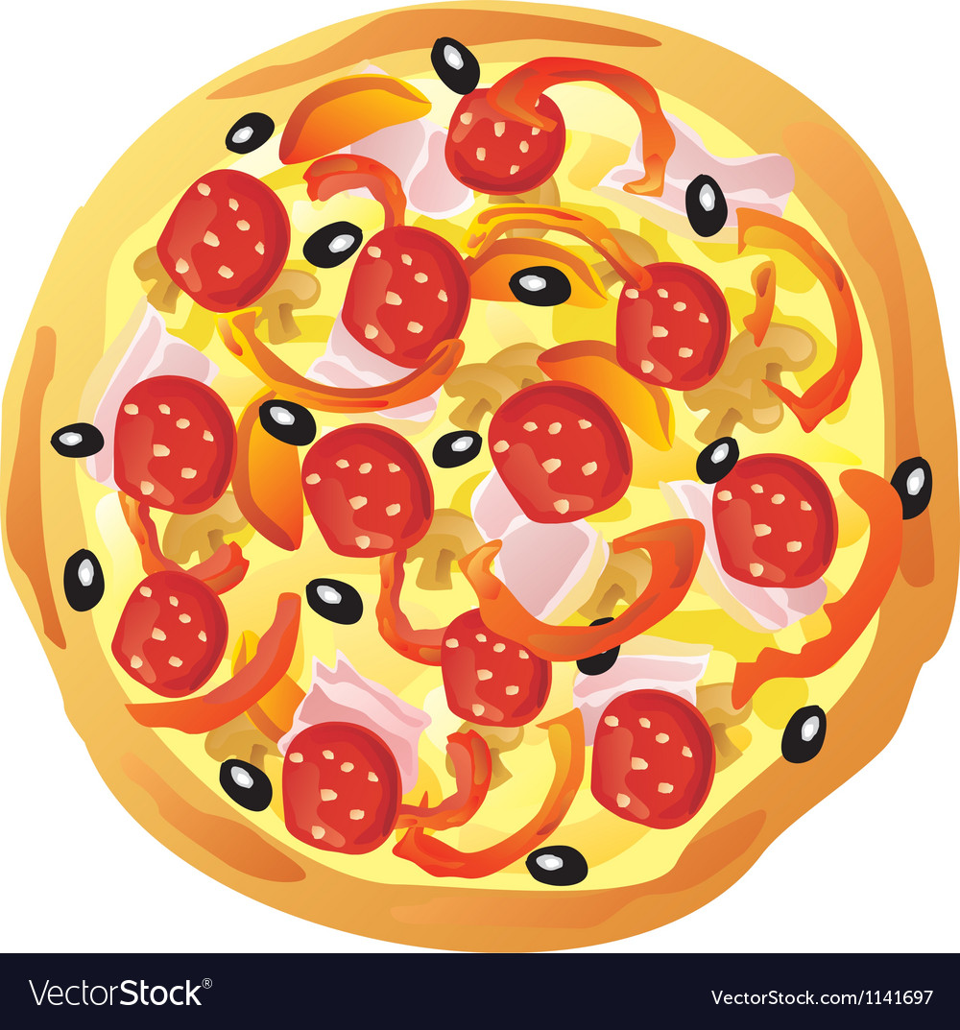
Sociolinguistics & Semiotics
Sign (Peirce CP 2.228):
A sign (or “representamen”)
is something which stands for something else (its “object”).
It creates in the mind of the “interpreter”
a related sign (the “interpretant”).
Tradition
Sign

Slide 7
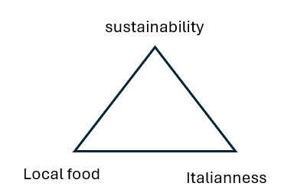
The Peircean-ochsean sign
E.g. An Italian migrant in England valuing Italian food culture’s emphasis on sustainability, who chooses to shop in local/independent stores rather than supermarkets.
Social categories related to nationality are indexically constituted through food practices through the intermediary of values, beliefs, stances, embodied behaviours and social activities.

Slide 8

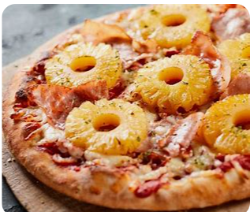
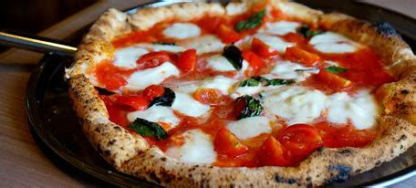

Enregisterment
Italianness
​
Italianness
​

Slide 9
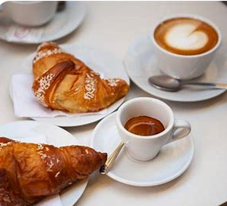
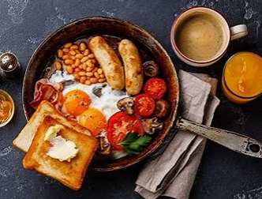
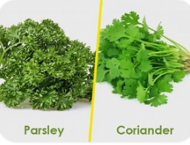
Crossing
Rampton (1995, p. 485):
"Code alternation by people who are not accepted members of the group associated with the second language that they are using."
An Italian in England regularly having English breakfast instead of coffee and biscuits
An Italian in England inspired by Indian friends to cook with coriander instead of parsley

Slide 10
Our data
Italian academics in the NW England
2020 [+2018]
9 semi-structured interviews [+10]
Unprompted food talk
Thematic sorting: Passages where following were discussed
Particular foods and drinks
Food and drinks preparation and consumption processes/events
Places where food and drinks are consumed

Slide 11
A case study

Slide 12
Valerio Giorgi
A medical doctor and an academic
82.JH Exactly. But when you talk to me about readjustment[…]are there aspects of the way you relate to others that have now become part of you, even if they’re more British than Italian, and that you feel like you're bringing back to Italy with you?
83.VG Yes, yes, yes. There’s a way of not being direct that’s typical of English culture. When you have to express an opinion—especially a negative one—that doesn’t exist in Italy. In Italy, people are much more open, much more direct. So, I notice it even in conversations among friends at the bar, you know? I’m a bit traumatised by how direct they are sometimes when telling you things. It’s a small thing, but you get used to a certain way of saying things. That’s something a bit... like that (CHUCKLES) (it’s kind of a class marker), but anyway—what else? Yes, then, you know, at the heart of things, there are some passions that are very similar, like politics and sport, really—others, a bit less so. There’s not the same attachment to family. In that regard, I actually find myself closer to the English than the Italians (LAUGHTER)—but that’s just how I am, eh (CHUCKLES).
84.JH Ok, so, on the flip side, what are those traits or traditions or customs from Italy that you consciously, actively maintain here in the UK to keep that connection to Italy alive?
85.VG Well, the food. Sorry, it may sound cliché, but I think the culture—the meal, eating, what to eat, that certain attention—it’s part of it, it’s an important part of our culture. In my professional world, when I work as a doctor, I bring a certain attention to detail that I notice is more typical of Italian medicine in terms of patient care. There’s much more attention, much more care, at least in my experience, right? As an Italian doctor, from when I used to work in Italy. So, I try to bring that here.

Slide 13
[Representamen (R)]
“indirectness”
[Intermediator (I)] trauma
▸ stance: discreet, sophisticated
▸ activity: behaving politely
▸ social act: embodying British cultural values
[Object (O)]
“Britishness”
ENREGISTERMENT
CROSSING WITH CORPOREAL/AFFECTIVE EFFECTS
Notes:
trauma: corporeal and affective effect (materiality of the border)
Indirectness is appropriated as cultural code with effects [possible through enregisterment as a meta-reflection or else our participants couldn’t bring us this example, minimum second order style shifting or third order, a value-based association, to be sophisticated you need to be subtle -> also aesthetics]
Estranged by directness in Italy linked to transgression of social class as marked by disagio
Self-attributed belonging to britishness (his declaration of belonging)

Slide 14
[Representamen (R)]
“food”
[Intermediator (I)] corporeal and aesthetic pleasure
▸ stance: attentive, ethical
▸ activity: cooking, caregiving
▸ social act: embodying Italian cultural values
[Object (O)]
“Italianness”
ENREGISTERMENT
CROSSING WITH
CORPOREAL/AESTHETIC EFFECTS
Notes:
pleasure: corporeal and affective effect (materiality of the border)

Slide 15
Valerio’s Britalian identity
CLASS AS A SEMIOTIC SITE OF IDENTITY CONSTRUCTION
Aesthetics
Across domains:
Personal &
professional
Italian care for details
British sophistication
Notes:
Valerio crosses and transgresses social borders of national identity to align himself with the aspect of the given culture that more closely reflects his aesthetic values.
Despite the use of a well put together and clearly delineated triangle, this is to show that hybrid identities are not harmonious beings but fragmented and often value-driven/based
Materiality of border crossing produces a reality that is both corporeally and ethically pleasing

Slide 16
contribution
This study...
Demonstrates one way to operationalize BAM at the micro level
Shows how food/drink practices act as semiotic sites of bordering
Begins to bridge a methodological gap
Notes:
This study demonstrates how to operationalize BAM at the micro level through the analysis of cultural discourse (e.g., food, authenticity, stereotypes).
Shows how food and drink practices act as semiotic sites of bordering, where inclusion/exclusion and authenticity are negotiated (e.g., contested Italianness).
Bridges a methodological gap: while BAM and political geography are rarely integrated with SL/DA, this study offers a roadmap for interdisciplinary methodological integration

Slide 17
Conclusion & Future Directions: BAM --> SS
Embedding BAM into Sociosemiotics
“Bringing the border from the margins to the centre of the analysis”
Historicising bordering processes ✅
Analysing migrant subjectivities ✅
Illuminating how material-discursive practices shape identity ✅
And critically reflecting on how borders function ✅

Slide 18
Conclusion & Future Directions: SS --> BAM
Embedding Sociosemiotics into BAM
Conceptual “tools” and empirical methods
to study identity and borders as lived experiences.
Focus on identity
Indexicality, enregisterment, crossing etc ​
Social constructivist views of identity
Poststructuralist concepts
Discourse Analytical ways to analyze identity
Targeted RQs thematizing borders
>> not so easy when borders are symbolic!

Slide 19

Thank you!

Slide 20
82 | 36:48.9 - 37:10.3 | JIH Esatto. Ma quando mi parli di readjustment, ad esempio no quando torni in Italia, ci sono delle componenti del modo in cui tutti i rapporti con gli altri che comunque oramai fanno parte anche se sono piú British che italiane e che ti senti di starle importando in Italia?
83 | 37:10.3 - 38:35.7 | Sí, sí, sí. C'é un modo di non essere diretti che é tipico della cultura inglese. Quando tu devi esprimere una una tua opinione, soprattutto se negativa che che non hai in Italia. In Italia è molto più aperto- sei molto più diretto, quindi io noto quando anche nelle conversazioni tra amici al bar, no, che rimango un pochino traumatizzato dal modo in cui sono diretti no, a volte nel dirti le cose e quello è una cosa molto banale, però sai, ti abitui, no a un certo modo di dire le cose. Quella é una cosa un po' cosí (CHUCKLES) (fa ceto) ma insomma- che altro? Sí, poi sai ci sono molto- poi se guardi poi al cuore delle cose, poi sai ci sono anche certe passioni che sono anche molto simile, la politica, lo sport cioé veramente- altre un po' meno, non c'è tutto questo attaccamento alla famiglia. Lá mi ritrovo più tra gli inglesi ti diró che tra gli italiani (LAUGHTER), poi questo sono- é per come sono fatto io, eh. (CHUCKLES)
84 | 38:35.7 - 38:56.0 | JIH Ok, ecco, invece, se dovessimo ribaltare la domanda quali sono quei tratti o quelle tradizioni quelle usanze italiane che tu consciamente attivamente tieni qua nel Regno Unito per mantener vivo quel quella connessione con l'Italia?
85 | 38:56.0 - 39:57.4 | Beh il cibo. Scusami, sará anche lí banale ma secondo me la cultura- proprio la- il pasto, l'alimentazione cosa mangiare se- una certa attenzione, no alla- é parte, é parte secondo me importante della nostra cultura. Nel mondo professionale, quando faccio il medico ho- porto una certa attenzione ai dettagli che noto che è più tipica della medicina italiana nella nell'assistenza del malato. C'è molta più attenzione, molta più cura molto più- almeno della mia esperienza, no, di medico italiano di quando lavoravo in Italia. Quindi cerco di portarla qui.
86 | 39:57.4 - 40:04.3 | JIH Questo é molto interessante. Ora questa non é una domanda inclusa nella-
87 | 40:04.2 - 40:41.0 | Sí, c'é molta piú- qui c'é molto piú tasks shiffting delle nurses, molta piú suddivisione del lavoro, c'é molta anche piú organizzazione superiore peró- e forse magari é per questo che in Italia tu ti fai piú carico e sei piú, no, cosí (decenzi) anche di meno, insomma c'é anche meno personale, peró questa attenzione ai dettagli, insomma- Ma forse, ripeto, é piú della mia esperienza personale che generalizzando il sistema paese.

Slide 21
SOCIOSEMIOTIC CONCEPTS IIi
[3] Crossing (~Rampton 1995) The practice of adopting semiotic resources not conventionally associated with one’s own group.
Straight-crossing: the practice of adopting semiotic resources not conventionally associated with one’s own group but converging to the social group whose norms are expected.
e.g. an Italian in England regularly having English breakfast​

Slide 22

SOCIOSEMIOTIC CONCEPTS IV
Side-crossing: the practice of adopting semiotic resources not conventionally associated with one’s own group but also different to the ones of the social group whose norms are expected.
e.g. an Italian in England inspired by Indian friends to cook with coriander instead of parsley
Counter-crossing (~Holmes & Schnurr 2006): the practice of using semiotic resources conventionally associated with one’s own group in contexts where norms from a different group are expected.
e.g. an Italian working for a multinational company in England, where making instant coffee is the norm, who keeps making coffee with a moka pot in the company’s office kitchen.
Notes:
The Chinese restaurant example would be side crossing: italian migrant going to chinese restaurant – in contrast to the pub (the pub would have been straight crossing) and it is explicitly rejected in the excerpt. Incidentally – in terms of sign, we have: R = chinese food, O = Italianness, I = familiarity, authenticity.

